Slide 1
Analysing Amazon Sales data

Slide 2
Problem Statement:
Sales management has gained importance to meet increasing competition and the need for improved methods of distribution to reduce cost and to increase profits. Sales. Management today is the most important function in a commercial and business. enterprise.Do ETL: Extract-Transform-Load some Amazon dataset and find for me. Sales-trend -> month-wise, year-wise, yearly_month-wise .Find key metrics and factors and show the meaningful relationships between attributes.

Slide 3
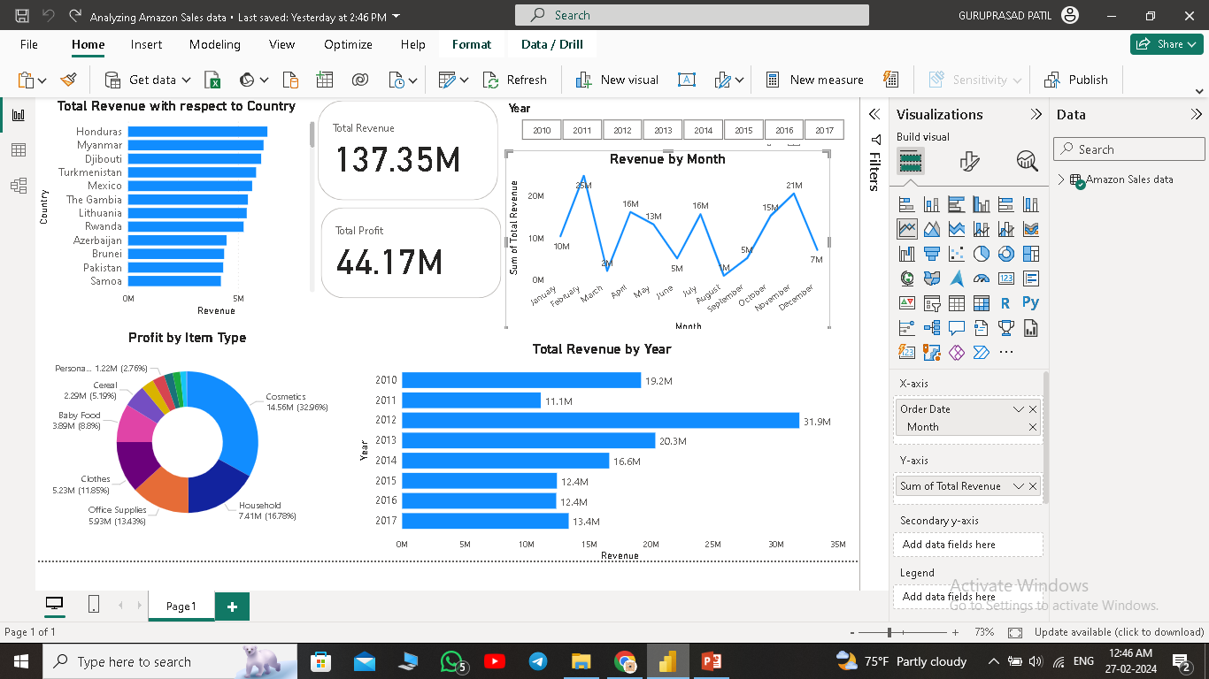

Slide 4
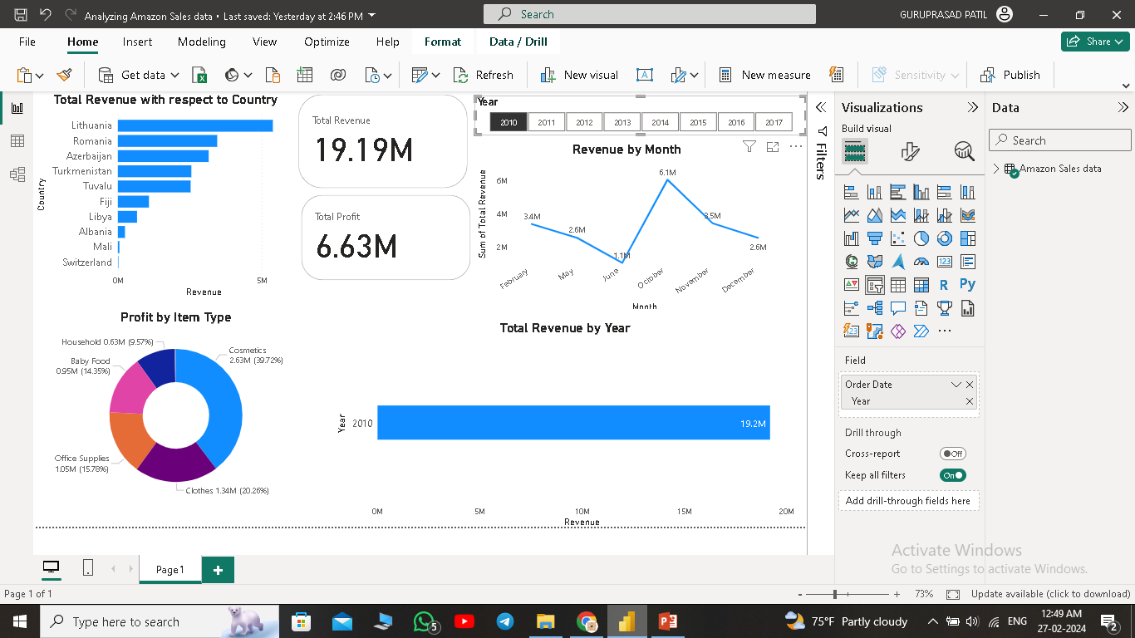

Slide 5
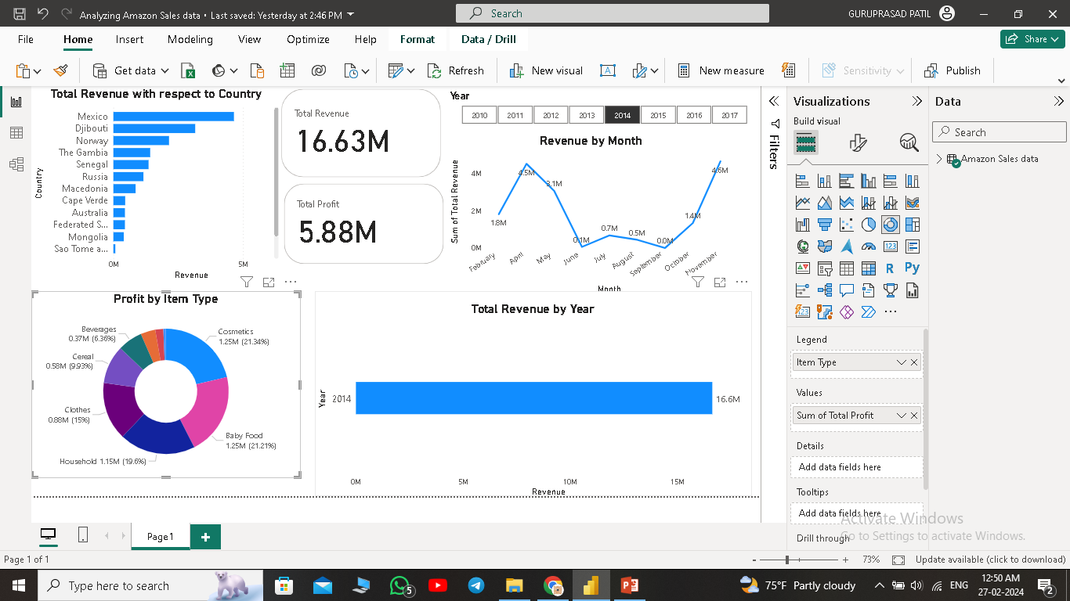

Slide 6
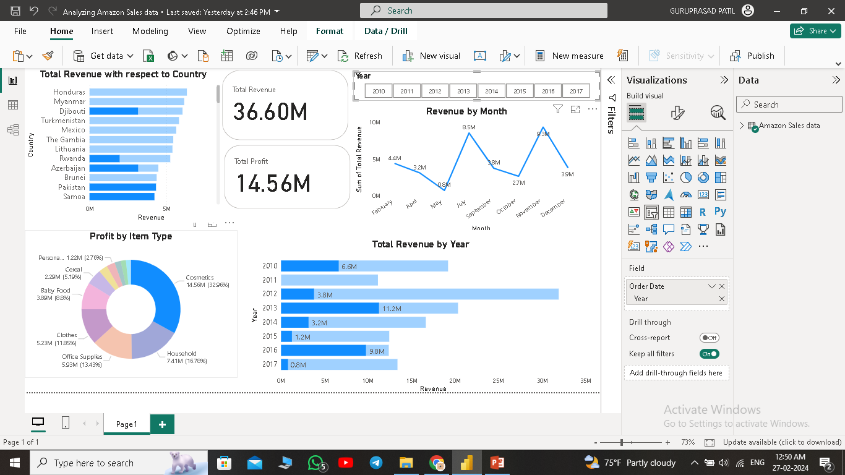

Slide 7
Thank You

